Slide 1
Score-Based Models
lecture 13
CS236: Deep Generative Models

Slide 2
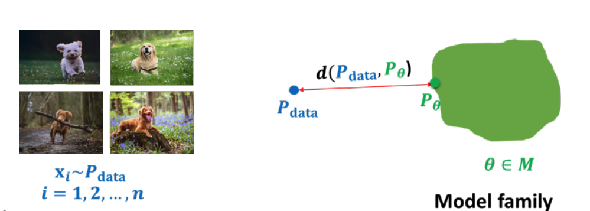
Summary

Slide 3
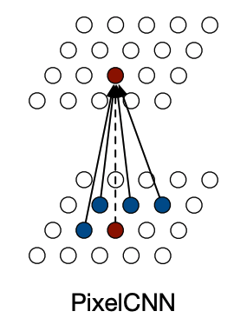
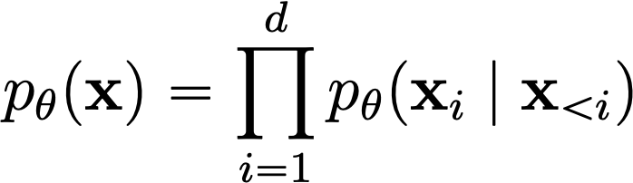
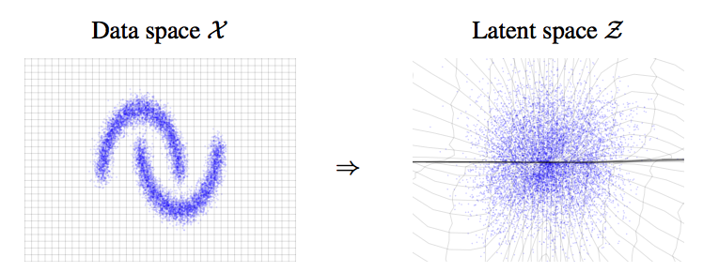
How to represent probability distributions?
Probability density function (p.d.f.) or probability mass function (p.m.f.)
Autogressive models
Flow models
Notes:
Generative modeling is the task of learning a model of probability distribution from data. However, how can we represent a probability distribution? There are many ways, and generative models can be largely categorized according to this.
One common way of representing the probability distribution is the probability density function.
We have many popular density models that model the probability density function. They can be trained by maximum likelihood.

Slide 4
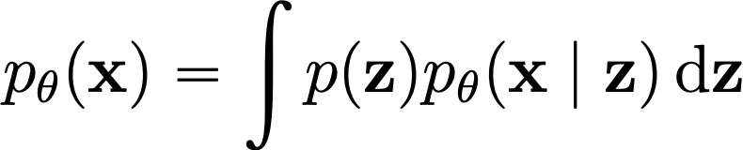
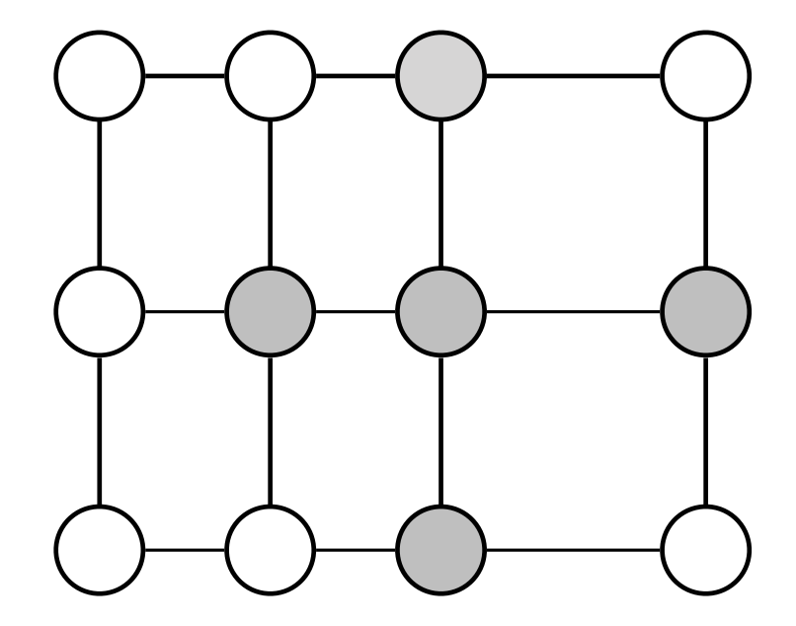
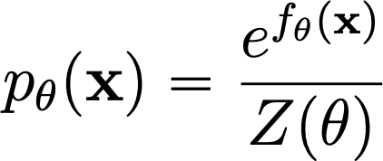
How to represent probability distributions?
Probability density function (p.d.f.) or probability mass function (p.m.f.)
Variational autoencoders
Energy-based models
Notes:
Generative modeling is the task of learning a model of probability distribution from data. However, how can we represent a probability distribution? There are many ways, and generative models can be largely categorized according to this.
One common way of representing the probability distribution is the probability density function.
We have many popular density models that model the probability density function. They can be trained by maximum likelihood.

Slide 5
How to represent probability distributions?
Probability density function (p.d.f.) or probability mass function (p.m.f.)
Pros
Maximum likelihood training
Principled model comparison via likelihoods
Cons
Special architectures or surrogate losses to deal with intractable partition functions
Notes:
Generative modeling is the task of learning a model of probability distribution from data. However, how can we represent a probability distribution? There are many ways, and generative models can be largely categorized according to this.
One common way of representing the probability distribution is the probability density function.
We have many popular density models that model the probability density function. They can be trained by maximum likelihood.

Slide 6
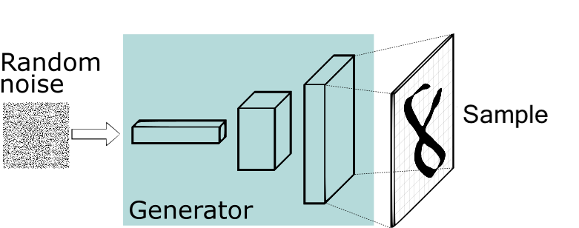
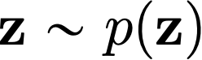
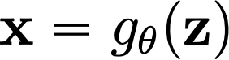
How to represent probability distributions?
Sampling process
Generative adversarial networks (GANs)
GAN
Notes:
In addition to the probability density function, we can also use iid sampling process to represent a probability distribution.
In general, many sample generation processes can be viewed as first drawing \epsilon from a simple and well-known prior distribution p(\epsilon), and then mapping \epsilon through a deterministic transformation g_\theta to get a sample x. In order to model a sample generation process, we can simply model the deterministic transformation g_\theta.
The typical example of such a model is the generative adversarial networks. GANs can be learnt from data using adversarial training approaches.

Slide 7
How to represent probability distributions?
Sampling process
Pros
Samples typically have better quality
Cons
Require adversarial training. Training instability and mode collapse.
No principled way to compare different models
No principled termination criteria for training
Notes:
In addition to the probability density function, we can also use iid sampling process to represent a probability distribution.
In general, many sample generation processes can be viewed as first drawing \epsilon from a simple and well-known prior distribution p(\epsilon), and then mapping \epsilon through a deterministic transformation g_\theta to get a sample x. In order to model a sample generation process, we can simply model the deterministic transformation g_\theta.
The typical example of such a model is the generative adversarial networks. GANs can be learnt from data using adversarial training approaches.

Slide 8
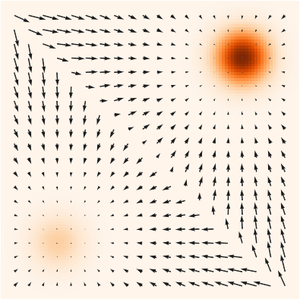
How to represent probability distributions?
When the pdf is differentiable, we can compute the gradient of a probability density.
Score function
(pdf and score)
(Electrical potentials and fields)
Notes:
In this talk, I am going to focus on another way of representing a probability distribution. Notice that when the pdf function is differentiable, we can compute the gradient of a probability density wrt the random variable. This gradient is widely known as the score function of a probability distribution.
In the following image, we show scores and probability density function together for a mixture of Gaussian. The pdf function is color coded, and darker colors indicate higher probability densities. The score is a vector field of gradients that point to directions where probability densities grow most quickly.
The relationship between score and probability density is analogous to the relationship between electric field and electric potential. We know that electric fields and electric potentials are just equivalent ways of describing the same physical phenonmenon. Intuitively, scores and probability densities are also equivalent ways of describing the same continuous probability distribution.
Also in the later part of the talk, we will also see how scores are related to the previous two representations of the probability distributions.

Slide 9
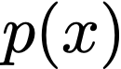
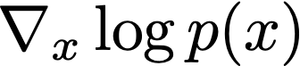
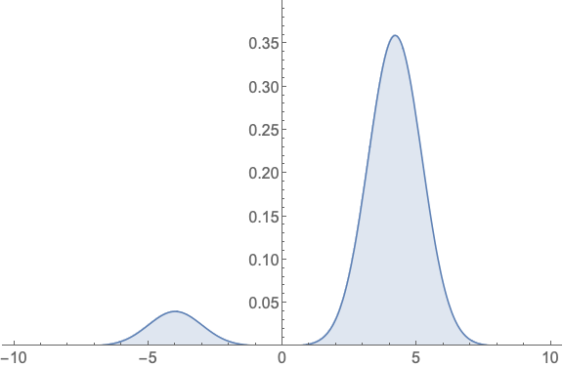
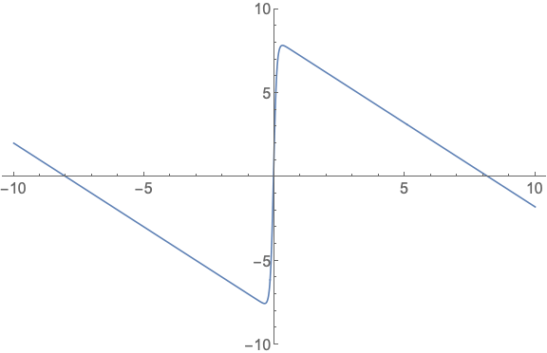
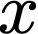
How to represent probability distributions?
When the pdf is differentiable, we can compute the gradient of a probability density.
Score function
Notes:
In this talk, I am going to focus on another way of representing a probability distribution. Notice that when the pdf function is differentiable, we can compute the gradient of a probability density wrt the random variable. This gradient is widely known as the score function of a probability distribution.
In the following image, we show scores and probability density function together for a mixture of Gaussian. The pdf function is color coded, and darker colors indicate higher probability densities. The score is a vector field of gradients that point to directions where probability densities grow most quickly.
The relationship between score and probability density is analogous to the relationship between electric field and electric potential. We know that electric fields and electric potentials are just equivalent ways of describing the same physical phenonmenon. Intuitively, scores and probability densities are also equivalent ways of describing the same continuous probability distribution.
Also in the later part of the talk, we will also see how scores are related to the previous two representations of the probability distributions.

Slide 10
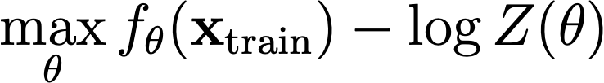
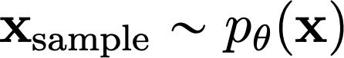
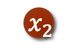
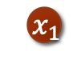
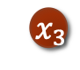
Recap on energy-based models
Deep Energy-Based models (EBMs)
Maximum likelihood training:
Contrastive divergence
Requires iterative sampling during training
$${ x}_{1}$$
$${ x}_{2}$$
$$x_{3}$$
Notes:
So why should we care about the score function instead of the probability density function? Let's consider learning a deep energy-based model.
A deep energy-based model is a model of probability density functions. It is defined by an arbitrary real-valued function f_\theta.
In order to define a probability distribution, we take the exponential of negative f_\theta to make it positive, and normalize it with a normalizing constant Z_\theta, which is commonly known as the partition function.
However, it’s usually hard to compute the partition function. Therefore, it’s usually treated as an unknown quantity. This is a very flexible model, but learning is tricky.
The typical way is maximizing the expected likelihood on the data distribution. Evaluating the expectation is easy because we can easily estimate it with samples. However, the likelihood involves the log partition function.

Slide 11
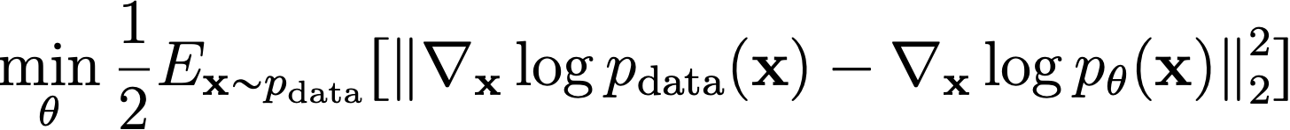
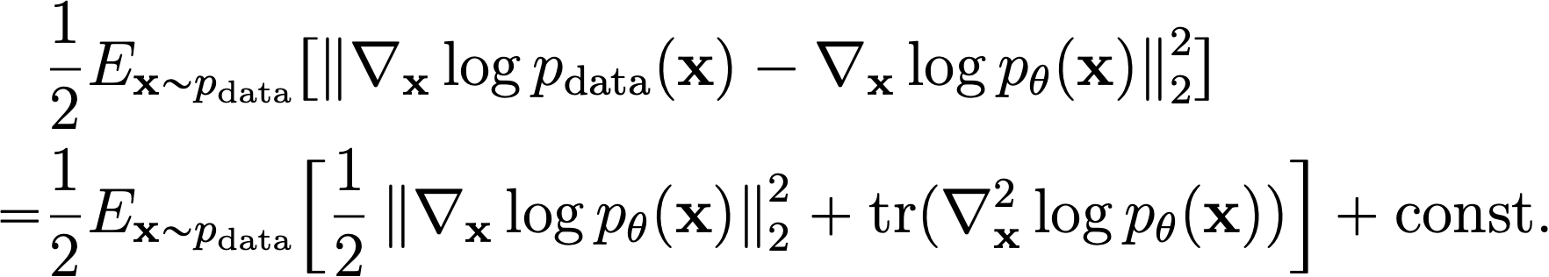
Recap on energy-based models
Deep Energy-Based models (EBMs)
Minimizing Fisher divergence:
Score matching
$${ x}_{1}$$
$${ x}_{2}$$
$$x_{3}$$
Notes:
So why should we care about the score function instead of the probability density function? Let's consider learning a deep energy-based model.
A deep energy-based model is a model of probability density functions. It is defined by an arbitrary real-valued function f_\theta.
In order to define a probability distribution, we take the exponential of negative f_\theta to make it positive, and normalize it with a normalizing constant Z_\theta, which is commonly known as the partition function.
However, it’s usually hard to compute the partition function. Therefore, it’s usually treated as an unknown quantity. This is a very flexible model, but learning is tricky.
The typical way is maximizing the expected likelihood on the data distribution. Evaluating the expectation is easy because we can easily estimate it with samples. However, the likelihood involves the log partition function.

Slide 12
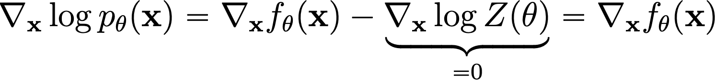
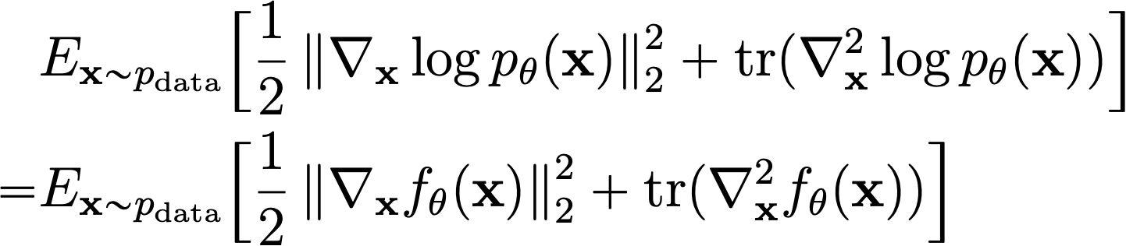
Score matching for training EBMs
Score function of EBMs
Score matching for EBMs:
Is score matching limited to EBMs?
Autoregressive models
Normalizing flow models
Notes:
So how can we bypass the intractble partition function? Let's consider the score. It only depends on the gradient of log partition function, which is zero....
Suppose we have the vector field of data scores and model scores. it's clear to see that .....
Suppose we know the data score, we can learn the parameters by ... which does not involve the intractable partition function. This is when score estimation becomes very useful.
Learning generative models is only one application of scores. As a preview...

Slide 13
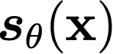
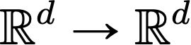
Score-based models
What’s the most general model that can be efficiently trained by score matching?
Score-based model
?
EBMs
MAFs
flow
Auto-
regressive
Directly model the vector field of gradients!

Slide 14
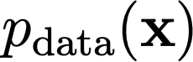
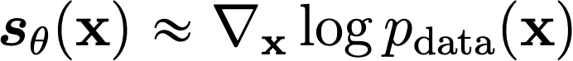
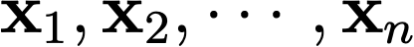

Score estimation by training score-based models
Probability density
i.i.d. samples
Score function
Notes:
Let's have a formal framework for score estimation.
Intuitively, we have a hidden probability distribution. And the only way to access this distribution is through its iid samples. Now, our task is to estimate the score function using only iid samples. We call this task score estimation.

Slide 15
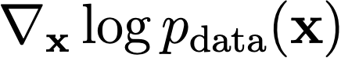
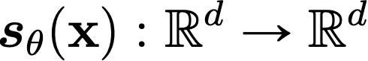
Score estimation by training score-based models
Given: i.i.d. samples
Task: Estimating the score
Score Model: A learnable vector-valued function
Goal:
How to compare two vector fields of scores?
Average
Euclidean distance
over the space
Notes:
Formally, ...
We propose a score model.
In order to learn the score model, we need some objective to measure the difference between ...
Suppose we have the vector field of scores of p..

Slide 16
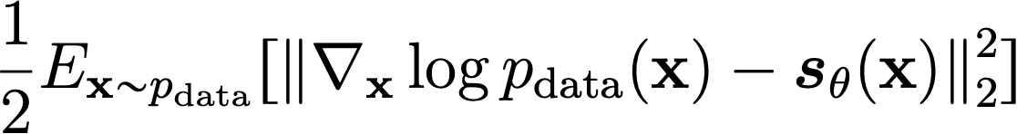
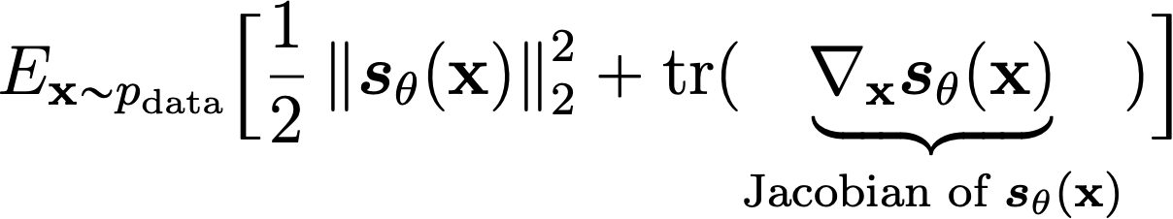
Score estimation by training score-based models
Objective: Average Euclidean distance over the whole space.
Score matching:
Requirements:
The score model must be efficient to evaluate.
Do we need the score model to be a proper score function (i.e., gradient of a scalar “energy” function)?
(Fisher divergence)
Notes:
Mathematically, the objective can be written as ...
Unfortunately, we can only sample from p(x), and we don't know the score of p in the Fisher divergence objective.
Luckily, we can use integration by parts...
To gain some intuition, we first consider 1-D fisher divergence.
Analogously, we can obtain the following equivalent form to N-D Fisher divergence using integration by parts.
The expectation can be approximated using iid samples. Draw, empirical average.

Slide 17
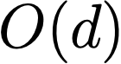



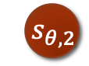
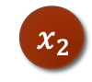




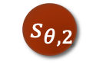
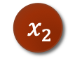

Score matching is not scalable
Deep neural networks as more expressive score models
Compute and
$${ x}_{1}$$
$${ s}_{θ,1}$$
$${ x}_{2}$$
$${ s}_{θ,2}$$
Score Matching
is not Scalable!
$$x_{3}$$
$${ s}_{θ,3}$$
Backprops!
$${ x}_{1}$$
$${ s}_{θ,1}$$
$${ x}_{2}$$
$${ s}_{θ,2}$$
$$x_{3}$$
$${ s}_{θ,3}$$
Notes:
In practice, we can increase the expressive power of our score model by parameterizing it as a deep neural network.
In order to use score matching to estiamte our score model,...
Score matching is not very scalable for high dimensional datasets.

Slide 18
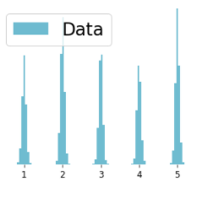
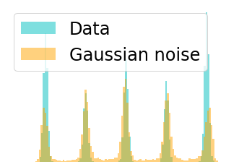
Denoising Score Matching (Vincent, 2011)
Consider the perturbed distribution
Score estimation for is easier
If the noise level is small, this is a good approximation
Notes:
How can we scale up score matching to learn deep score models on high dimensional datasets? The key is to eliminate the trace of Jacobian term in the training objective.
One existing method to do this is called denoising score matching. Instead of estimating the score of p, denoising score matching estimates the score of a perturbed version of p.
Specifically, denoising score matching considers a perturbation kernel q(. | .), which is usually just a Gaussian distribution with mean..
We denote q_sigma as the marginal
When sigma is small,
Denoising score matching shows that if we replace the score p with the score of q_sigma in the Fisher divergence objective, then it has an equivalent form which is scalable to compute.
To see this,...
Can mention Stein unbiased estimator
Therefore, dsm is scalable to ....
However, denoising score matching suffers from inaccurate score estimation because of the perturbation.

Slide 19
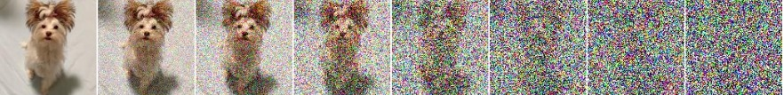
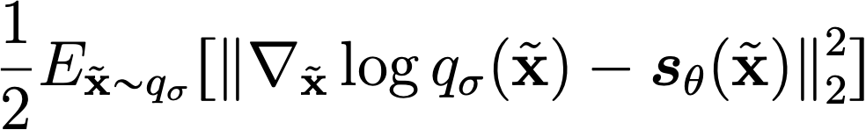
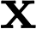
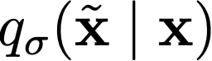
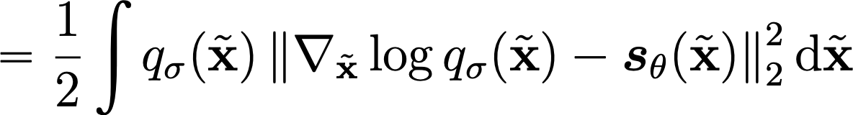
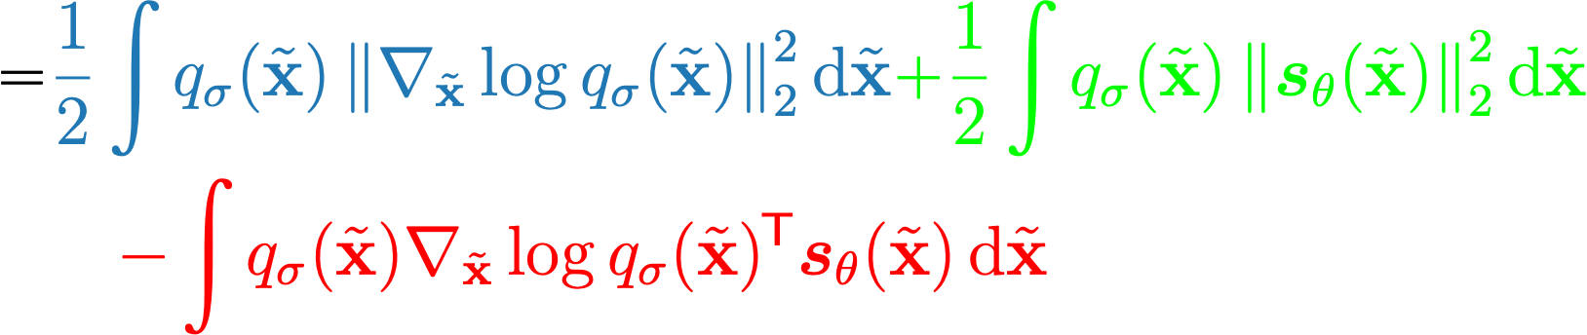
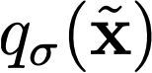
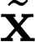
Denoising score matching
Denoising score matching (Vincent 2011): matching the score of a noise-perturbed distribution

Slide 20
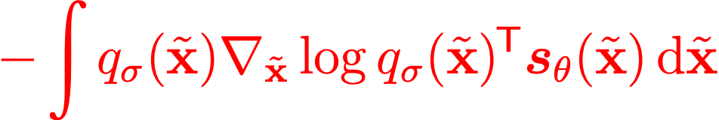





Denoising score matching
Denoising score matching

Slide 21

Denoising score matching
Denoising score matching

Slide 22




Denoising score matching
Estimate the score of a noise-perturbed distribution
is easy to compute
Pros: efficient to optimize even for very high dimensional data, and useful for optimal denoising.
Con: cannot estimate the score of clean data (noise-free)
Notes:
How can we scale up score matching to learn deep score models on high dimensional datasets? The key is to eliminate the trace of Jacobian term in the training objective.
One existing method to do this is called denoising score matching. Instead of estimating the score of p, denoising score matching estimates the score of a perturbed version of p.
Specifically, denoising score matching considers a perturbation kernel q(. | .), which is usually just a Gaussian distribution with mean..
We denote q_sigma as the marginal
When sigma is small,
Denoising score matching shows that if we replace the score p with the score of q_sigma in the Fisher divergence objective, then it has an equivalent form which is scalable to compute.
To see this,...
Therefore, dsm is scalable to ....
However, denoising score matching suffers from inaccurate score estimation because of the perturbation.

Slide 23





Denoising score matching
Sample a minibatch of datapoints
Sample a minibatch of perturbed datapoints
Estimate the denoising score matching loss with empirical means
If Gaussian perturbation
Stochastic gradient descent
Need to choose a very small $σ$!

Slide 24




Pitfall of denoising score matching
The loss variance will increase drastically as $σ→0$!
Denoising score matching loss for Gaussian perturbations
If we choose very small $σ→0$

Slide 25



Denoising Score Matching (Vincent, 2011)
Consider the perturbed distribution
Score estimation for is easier
Score matching
denoising
tries to estimate the noise that was added to produce
x
= x + noise
Notes:
How can we scale up score matching to learn deep score models on high dimensional datasets? The key is to eliminate the trace of Jacobian term in the training objective.
One existing method to do this is called denoising score matching. Instead of estimating the score of p, denoising score matching estimates the score of a perturbed version of p.
Specifically, denoising score matching considers a perturbation kernel q(. | .), which is usually just a Gaussian distribution with mean..
We denote q_sigma as the marginal
When sigma is small,
Denoising score matching shows that if we replace the score p with the score of q_sigma in the Fisher divergence objective, then it has an equivalent form which is scalable to compute.
To see this,...
Can mention Stein unbiased estimator
Therefore, dsm is scalable to ....
However, denoising score matching suffers from inaccurate score estimation because of the perturbation.

Slide 26



Tweedie’s formula
Score estimation for is equivalent to denoising
Tweedie’s formula
Optimal denoising strategy is to follow the gradient (score):
+
Adapted from Raphan and Simoncelli, 2010
Notes:
How can we scale up score matching to learn deep score models on high dimensional datasets? The key is to eliminate the trace of Jacobian term in the training objective.
One existing method to do this is called denoising score matching. Instead of estimating the score of p, denoising score matching estimates the score of a perturbed version of p.
Specifically, denoising score matching considers a perturbation kernel q(. | .), which is usually just a Gaussian distribution with mean..
We denote q_sigma as the marginal
When sigma is small,
Denoising score matching shows that if we replace the score p with the score of q_sigma in the Fisher divergence objective, then it has an equivalent form which is scalable to compute.
To see this,...
Can mention Stein unbiased estimator
Therefore, dsm is scalable to ....
However, denoising score matching suffers from inaccurate score estimation because of the perturbation.

Slide 27




Tweedie’s formula and denoising score matching
Denoising score matching is suitable for optimal denoising
Given , we can define the posterior with Bayes’ rule
Recall that
Tweedie’s formula:

Slide 28



Sliced score matching
One dimensional problems should be easier.
Consider projections onto random directions.
$$≈$$
$$≈$$
$$≈$$
Song*, Garg*, Shi, Ermon. "Sliced Score Matching: A Scalable Approach to Density and Score Estimation." UAI 2019.
Notes:
How can we avoid the problem of inaccurate score estimation while still being scalable? In our work, we propose sliced score matching. The motivating idea is that one dimensional problems should be much easier to solve for score matching.
We propose to project score vectors onto random directions, so that the vector field of scores becomes a scalar field. We then compare the projected scalar fields of data and model distributions.
For example, we have vector fields of scores for the data distribution and model distribution. We have picked two random directions. Then, we project all vectors onto those two directions.
It's clear to see that two vector fields are the same if and only if their projections onto all random directions are the same.

Slide 29


Sliced score matching
Objective: Sliced Fisher Divergence
Integration by parts
?
fast
Sliced Score Matching
Notes:
Mathematically, we summarize the intuition as a new objective named sliced Fisher divergence. Let's use v to denote random directions, and p_v to denote its distribution. The objective can be written as the expected squared difference between the projected scores of the data and model distributions.
We name this objective sliced Fisher divergence. Again, we don't know the data scores, so sliced Fisher divergence cannot be computed directly.
Fortunately, we can play the same trick of integration by parts, as done in score matching.
The objective is the sliced score matching objective. The second term involves the gradient of log p_\theta, which we already know that it can be computed by 1 backpropagation.
The first term still involves Jacobian, but it's in the form of Jacobian-vector products. So is the computation of this term scalable to high dimensions?

Slide 30
Computing Jacobian-vector products is scalable
One Backprop!
$${ s}_{θ,1}$$
Sliced Score Matching
is scalable
$${ x}_{1}$$
$${ x}_{2}$$
$${ s}_{θ,2}$$
$${ s}_{θ,3}$$
Slightly slower than denoising score matching
$$x_{3}$$
Notes:
The answer is yes. To see this, we first rewrite the first term of sliced score matching by explicitly writing the Hessian operator as composition of two gradient operators and moving one vector v inside.
Now we show that the computation can be done with two backpropagations.
As before, we first use one forward propagation to compute f_\theta.
Then we use one backward propagation to compute the gradient of f_\theta.
Next, we compute the inner product of v and the gradient of f_\theta, which is equivalent to adding one additional neuron to the computation graph.
Next, we backpropagate through the whole procedure to get the gradient of the inner product.
Finally, we compute the last inner product.
The whole procedure requires a number of backprop that does not depend on D.

Slide 31


Sliced score matching
Sample a minibatch of datapoints
Sample a minibatch of projection directions
Estimate the sliced score matching loss with empirical means
The projection distribution is typically Gaussian or Rademacher
Stochastic gradient descent
Can use more projections per datapoint to boost performance

Slide 32


Experimental results for sliced score matching
Sliced score matching methods
Other Baselines
Score Matching
Performance on
density estimation
Efficiency
Song*, Garg*, Shi, Ermon. "Sliced Score Matching: A Scalable Approach to Density and Score Estimation." UAI 2019.
Notes:
We tested sliced score matching on training energy-based models by matching their score to data score.
First, compared to the score matching method, sliced score matching is much more efficient. The curves show how the time needed per iteration grows w.r.t. the dimensionality of data. Results are better when lower. Sliced score matching, alongside several other baselines, is much faster than score matching.
Next, sliced score matching performs well on training EBMs for density estimation. The figure compares various score matching methods on a tabular dataset called WhiteWine. Results are better when lower. Sliced score matching methods do not lose much performance compared to score matching.

Slide 33











Score-based generative modeling
Score
Matching
?
Data samples
Scores
New samples
Notes:
So far, I have discussed how to estimate scores efficiently from iid samples of a distribution. We can have a score model, and then train it with some efficient variant of score matching to approximate the score of p.
Next, I will show how to build a generative model using the estimated score. This requires us to sample from the score model efficiently.

Slide 34






From scores to samples: Langevin MCMC
Scores
Follow the scores
Follow noisy scores:
Langevin MCMC
Notes:
How can we generate samples from scores? One method is Langevin MCMC.
Imagine that we have many random initial data points in the space, and we hope to move these random data points close to samples from the distribution? One intuitive approach might be following the vector field of scores to move our random points. However, this will cause all points to collapse to several local attractors.
Instead, there is a procedure called Langevin dynamics where we follow the scores but add a bit Gaussian noise. This is guaranteed to give correct samples under some conditions.

Slide 35






Langevin dynamics sampling
Sample from using only the score
Initialize
Repeat for
If $ε→0$ and $T →∞$, we are guaranteed to have
Langevin dynamics + score estimation
Notes:
Formally, Langevin dynamics is a method to sample from some distribution using only the score. It works by first sampling a initial sample from a simple prior distribution \pi(x). Then, it repeats the following recursive procedure. It first draws a Gaussian noise z, and then add an appropriate scaled version of this noise to the score vector, which is depicted in green.
When epsilon is infinitesimal, Langevin dynamics will produce exact samples in sufficiently long time. In practice, a finite value of epsilon only gives approximate samples, but many authors found the approximation error to be negligible in practical applications.

Slide 36

Score-based generative modeling
score
matching
Langevin
dynamics
Data samples
Scores
New samples
Notes:
So far, I have discussed how to estimate scores efficiently from iid samples of a distribution. We can have a score model, and then train it with some efficient variant of score matching to approximate the score of p.
Next, I will show how to build a generative model using the estimated score. This requires us to sample from the score model efficiently.

Slide 37

Score-based generative modeling: results
Final samples

Slide 38

Score-based generative modeling: results
Langevin sampling process

Slide 39

Pitfall 1: manifold hypothesis
Manifold hypothesis.
Data score is undefined.
Data points
Notes:
Unfortunately, score-based generative modeling does not work out of the box. We identify several pitfalls that pinpoint the reasons that it does not work well in practice.
The first pitfall is the manifold hypothesis. The manifold hypothesis states that in real world, data points lie in low-dimensional spaces with a much smaller dimension than the data dimension. For example, data points might lie on a two dimensional mobius strip, even though the data dimension is 3.
The score of data distribution is undefined when data are constrained to a low dimensional manifold. Intuitively, suppose the data distribution is concentrated around a ring. When the ring becomes thinner and thinner, the score vectors will also become larger and larger. In the limit that the ring becomes infinitely thin, the score vectors will also become infinitely large. This makes score vectors undefined on a low-dimensional manifold structure.

Slide 40


Pitfall 1: manifold hypothesis
Fitting the data with a low-dimensional linear manifold (PCA)
Score estimation on CIFAR-10.
3072
784
Dim
Dim
595
2165
Notes:
To show the manifold hypothesis is approximately true in practice, we conducted a toy experiment, where we use PCA to find a low-dimensional linear manifold that captures the dataset. Here is our result on MNIST. The first row shows original MNIST images, while the second row shows the result of projecting these images onto the linear manifold.The results show that MNIST images are close to a linear manifold with dimension xx, while the data dimension is. Similarly, most CIFAR-10 images are close to a linear manifold with dimension xx, while the data dimension is xx. Note that a linear manifold with much smaller dimensions is already close enough to all data. The dimension will be even smaller if we fit non-linear manifolds.
The manifold hypothesis indeed has strong negative effects on score estimation. Here is the result of using sliced score matching to estimate scores on the CIFAR-10 dataset. The learning curve first goes down fast and then fluctuates irregiularly and fail to converge.

Slide 41




Challenge in low data density regions
Accurate
Accurate
Inaccurate
Inaccurate
Accurate
Accurate
Langevin MCMC will have trouble exploring low density regions
Song and Ermon. “Generative Modeling by Estimating Gradients of the Data Distribution.” NeurIPS 2019.
Notes:
However, the naïve score matching plus Langevin MCMC does not work well in practice because score estimation is inaccurate in low data density regions.
To illustrate this fact, let’s consider a mixture of Gaussian distribution. The left figure is the data density. The middle figure shows ground-truth data scores, while the right figure shows estimated scores.
Comparing middle and right figures, score estimation is only accurate in the highlighted regions, which are those of high data density. For low-data density regions between the two modes, the score estimation is vastly inaccurate.
Why can this happen? This is because the score matching objective only considers the difference between data and model scores at data samples.
But in regions of low data density where almost no data samples are provided, there is not enough information to infer the correct scores from samples.
This challenge prevents Langevin MCMC from exploring low density regions properly using the learned score model. And it won’t produce good samples when the initialization is bad.

Slide 42





Pitfall 3: slow mixing of Langevin dynamics between data modes
Suppose the data distribution has two modes with disjoint supports:
Data score function:
The score function has no dependence on the mode weighting $π$ at all!
Langevin sampling will not reflect $π$
Notes:
The third pitfall is that Langevin dynamics mix slowly between different modes of the data distribution. Assume the data distribution is composed of two modes with disjoint support. The weight for the first mode is \pi, and the second mode is 1 - \pi. When computing the score in the support of the first mode, we get …. When computing the score in the support of the second mode, we get …. In either case, the score does not depend on the weight of mode \pi. Since Langevin dynamics only use scores, it will never recover the correct weight.
In fact, Langevin dynamics require the density to be differentiable, which is not the case here. But we can imagine that when the two modes are connected but almost disjoint, it will take Langevin dynamics a very long time to recover the weight of modes.

Slide 43

Pitfall 3: slow mixing of Langevin dynamics between data modes

Slide 44

After fixing these pitfalls (next lecture)
Song, Yang, and Stefano Ermon. "Generative Modeling by Estimating Gradients of the Data Distribution.” NeurIPS 2019.

